Slide 1
Assignment 6 Screenshots
Katie Hawthorne

Slide 2
Movable label: location, width, height, text

Slide 3
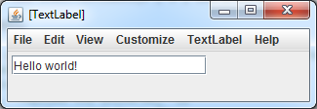
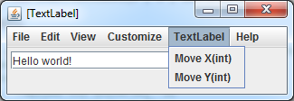

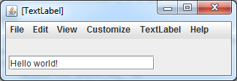
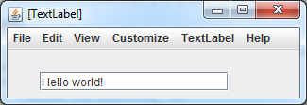
chat.TextLabel tl = new chat.TextLabel(0 , 0 , 200 , 20 , "Hello world!");
ObjectEditor.edit(tl);

Slide 4
Movable chat history: methods to add & remove, LIFO, can move all labels by same amount

Slide 5
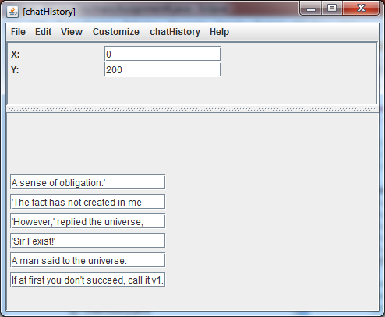
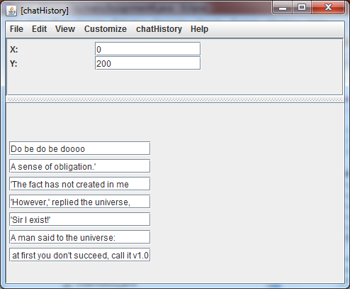

Add an element

Slide 6
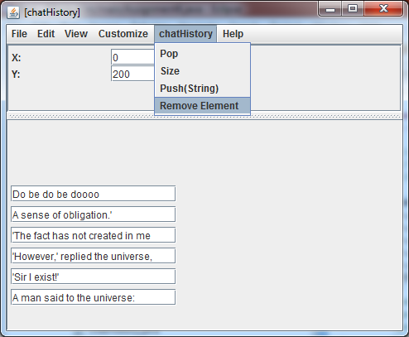
Remove an element from the bottom

Slide 7
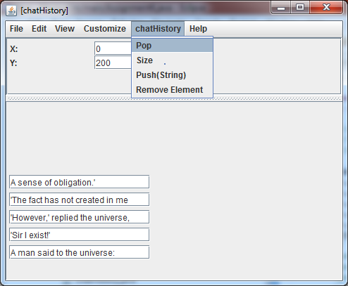
Remove an element from the top

Slide 8
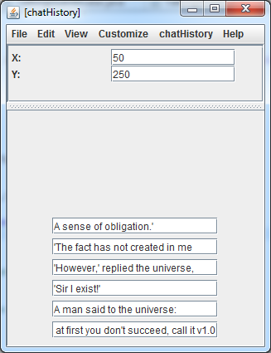


Move

Slide 9
Knight & guard avatars with chat history: methods for moving knight & guard together with chat history

Slide 10
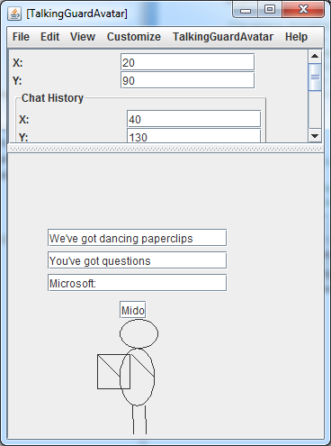
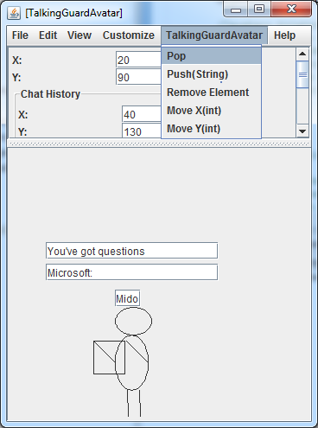

Slide 11
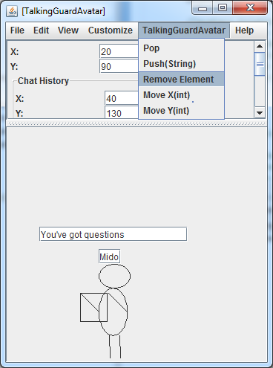
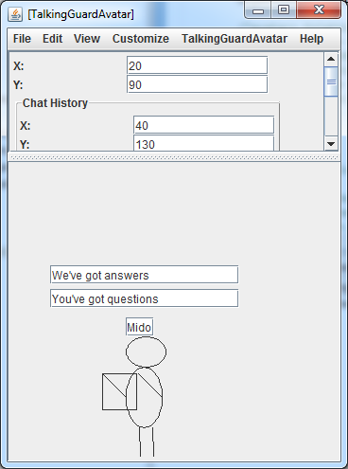


Slide 12
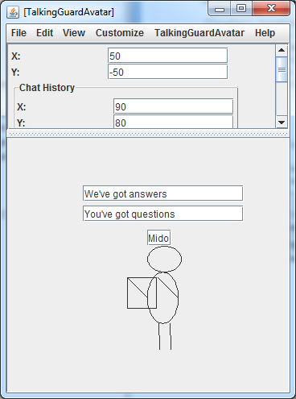
Use Move (x) and Move (Y) methods

Slide 13
And all the same works for the knight as well..

Slide 14
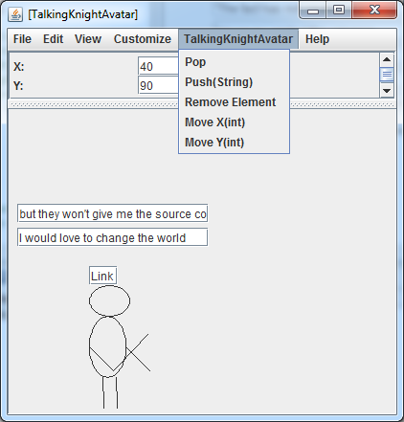
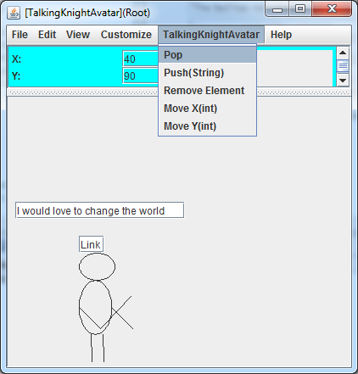

Slide 15

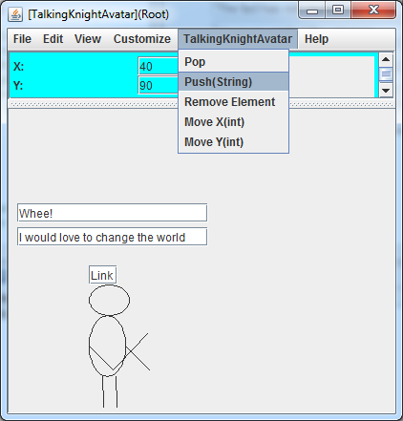
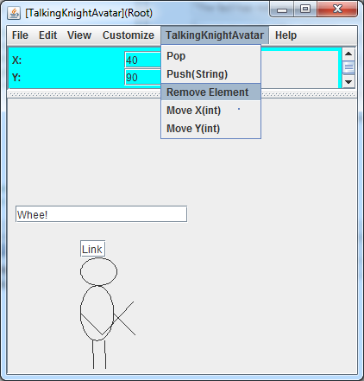

Slide 16


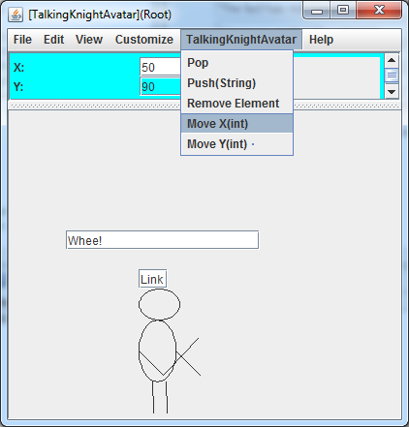
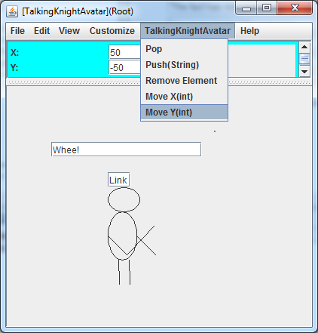

Slide 17
Collection of knights with chat history: can add & remove from both front & back, can move all knights by same amount

Slide 18
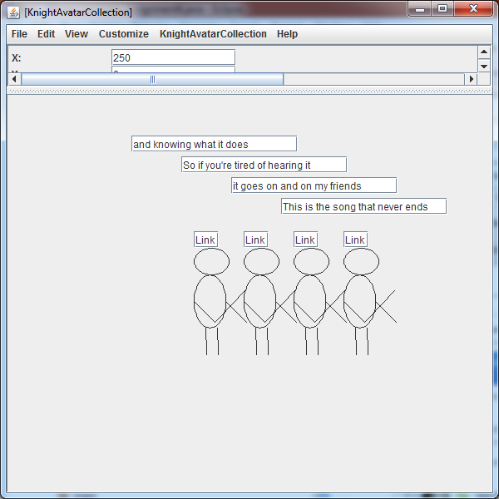

Slide 19


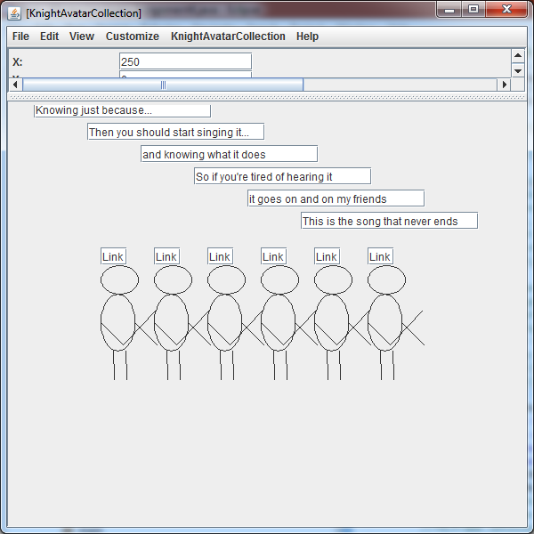

Slide 20
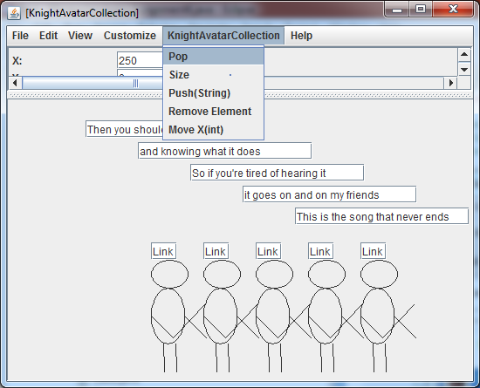
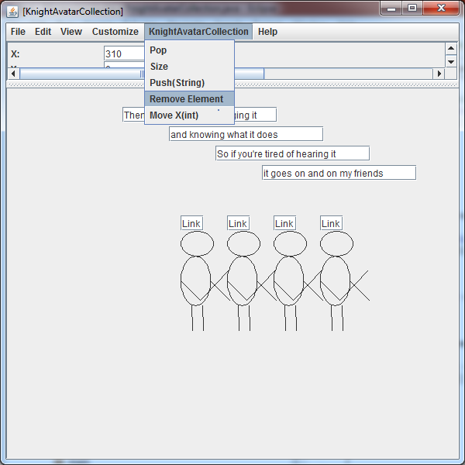

Slide 21
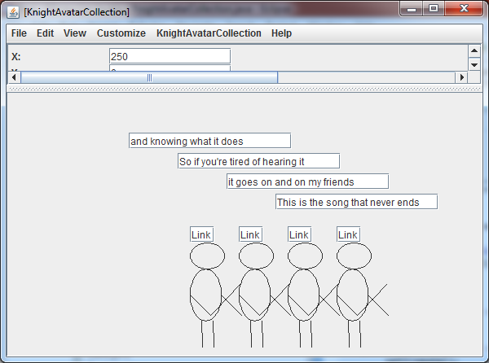


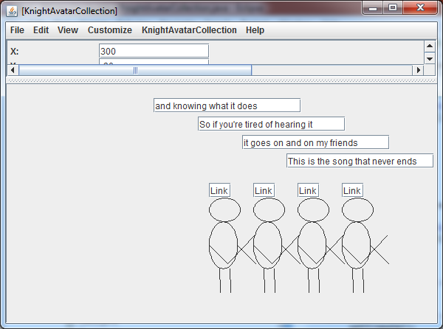

Slide 22
Scene object: two standing areas, gorge, bridge, guard with chat history standing in guard standing area, two collections of knights (left & right sides of bridge)

Slide 23
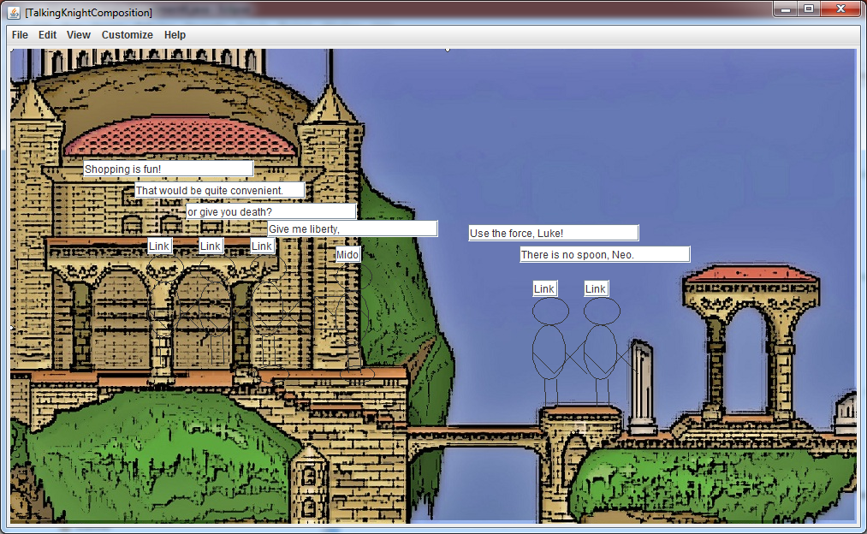
Aaand, the completed scene. Sorry the knights and such are still hard to see. I used textboxes instead of labels so you can actually enjoy the text.
=)

